Slide 1
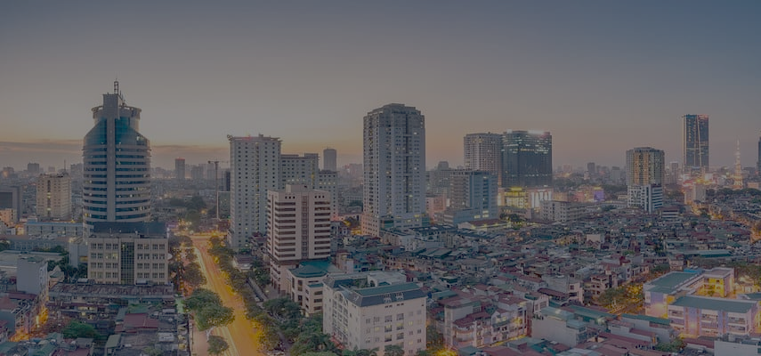


The 13th Korea-Vietnam
Green Chemistry Workshop
: Innovative Biotechnology and Energy Science
3rd–6th February 2026
Phenikaa University
The 13th Korea-Vietnam Green Chemistry Workshop (GCW) in 2026 will be held on February 3-6 (Tue-Fri), 2026 at Phenikaa University, Hanoi, Vietnam. The GCW will provide excellent opportunities to professors, lecturers, researchers, PhD./MS students, and industrial professionals to be exposed to current innovations in green chemistry.
The GCW will provide special talks and discussions to promote relationships among the green chemistry and chemical and biological engineering experts. The various and diverse local R&D efforts on green chemistry will also be highlighted.
- Call for Papers -
President,
We are pleased to invite you to share ideas, research results and cooperation proposals on the fields of green chemistry. Please contact organizers for more information.
There will be about 1 plenary and 9 invited talks. Posters are also presented for the specific topics of green chemistry. Detail program will be announced.
Chairs: Dr. Do Duy Phi (CSV, President) & Prof. U Hyeok Choi (KSIEC, Head of International Cooperation)
Organizing Committee
- Prof. Nguyen Viet Bac (CSV, Deputy President), Prof. Thai Hoang (CSV, Deputy President),
Prof. Nang Xuan Ho (Chairman, PHENIKAA University), Assoc. Prof. Van-Duong Dao (Vice Rector, PHENIKAA School of Engineering, PHENIKAA University), Prof. Vu Van Truong (vice – president, PHENIKAA University), Prof. Tran Dai Lam (IMS, Director), Assoc. Prof. Quang Le Dang (CSV)
- Prof. U Hyeok Choi, Prof. Sanghwa Jeong, Prof. Bonjae Koo, Prof. Seyoung Kim (KSIEC)
GCW Secretariat (Contact)
- Prof. Sanghwa Jeong (PNU) / sanghwa.jeong@pusan.ac.kr / Tel: 82-51-510-8539
- Assoc. Prof. Quang Le Dang (IMS, VAST) / ledangquang2011@gmail.com / CP: 84-91-300-1862
- Assoc. Prof. Van-Duong Dao (Phenikaa University)/ duong.daovan@phenikaa-uni.edu.vn

